Slide 1
Course End Project

Slide 2













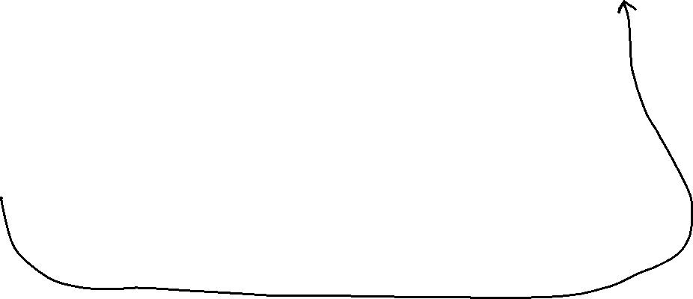





Slide 3



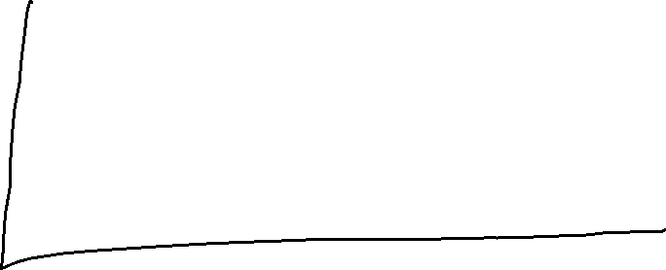

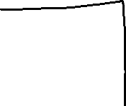






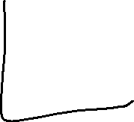







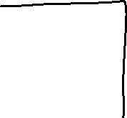


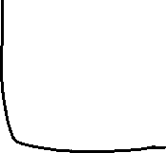


Slide 4
Steps
Create a VNet and a VM inside this VNet
Create a Storage Account
Create a container in Storage Account – Private Access
Extend identity of Virtual Network to Storage Account
Create some users.
Add then to a group – Operations Team
Grant this group an access on the Resource Group
Export the template from Resource Group

